Slide 1


Predicting Flight Profitability: A Machine Learning Model
This presentation outlines a machine learning approach to predicting flight profitability. By analyzing key features, we aim to provide actionable insights for profit maximisation.
By: Insight Seekers

Slide 2


Predicting Flight Profitability Introduction
Maximizing profitability in the airline industry is a multifaceted challenge influenced by various operational and financial factors. Our objective was to develop a high-performance machine learning model that not only predicts airline profitability with high accuracy but also provides explainability to help airline operators understand the key drivers of profitability and optimize their decision-making.
1
Optimize pricing:
Utilizing machine learning models to set competitive ticket prices based on demand.
2
Improve scheduling:
Enhancing flight schedules to meet peak demand times and minimize delays effectively.
3
Enhance customer experience:
Analyzing delays and service quality to boost overall satisfaction and loyalty.
4
Maximize asset efficiency:
Improving aircraft utilization and turnaround times to decrease operational costs and increase profits.

Slide 3


The Challenge: Optimizing Airline Profits in a Complex Landscape
Problem - 1
Problem - 2
Problem - 3
Understanding seasonal demand fluctuations in air travel
Impact of holidays on flight bookings
Variations in weekend versus weekday travel
Managing aircraft delays and turnaround times efficiently
Delays affect customer satisfaction ratings
Effective turnaround reduces operational complexities
Balancing costs while maximizing flight profitability and revenue
Analyzing revenue per available seat kilometer
Controlling operating expenses to ensure profitability
Financial Factors
Operational Efficiency
Revenue, operating costs, and net profit margins significantly impact profitability.
Flight delays, fuel efficiency, and ancillary revenue
all contribute to the bottom line.

Slide 4


Time & Seasonal Features
1
Scheduled Departure Time
Extracting month captures seasonality.
2
Actual Departure Time
Comparison with scheduled time helps analyze delays.
3
Day of Week
Reveals Average Delay by Day of the Week.
4
Month
Identifies seasonal demand variations.

Slide 5





Flight Performance Metrics
Delay (Minutes)
Turnaround Time (Minutes)
Aircraft Utilization (Hours/Day)
Delays impact profitability and customer satisfaction.
Efficient turnaround boosts operational efficiency.
Maximize flight time while considering maintenance.

Slide 6





Cost & Profitability Analysis
Revenue per ASK
Cost per ASK
Profitability per Flight
Revenue per ASK measures income per seat-km. Cost per ASK tracks expenses per seat-km. Profitability per flight equals revenue minus operating costs.

Slide 7


Data Exploration & Feature Engineering: Unveiling Profit Drivers
Data Preparation
Handle missing values and outliers.
Normalize/scale numerical features for better model performance.
Feature Selection
Identify key variables influencing profit.
Create new features that provide deeper insights.
Feature Engineering
Create new features to improve model accuracy.
Create derived features like revenue per seat, fuel cost per mile, or delay
impact score.
Capture seasonality trends using time-based features (month, day etc.).

Slide 8
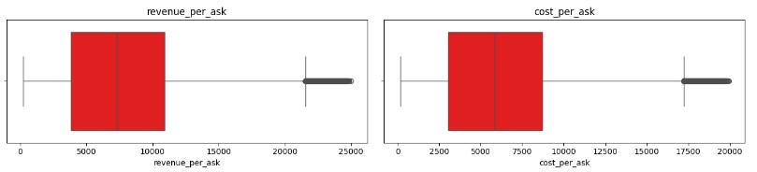
Outlier Detection and Handling:
📊 Analysis:
Revenue per ASK and Cost per ASK contain significant outliers, as shown in the box plots.
The presence of extreme values may impact model performance.
Handling Method:
We used the Interquartile Range (IQR) method to identify and remove/adjust outliers.
Formula:
IQR = Q3 - Q1
Lower Bound = Q1 - 1.5 * IQR
Upper Bound = Q3 + 1.5 * IQR
Values outside these bounds were either removed or capped at the threshold.
Impact:
Improved model stability by reducing extreme influence.
Enhanced data quality for better predictive accuracy.

Slide 9
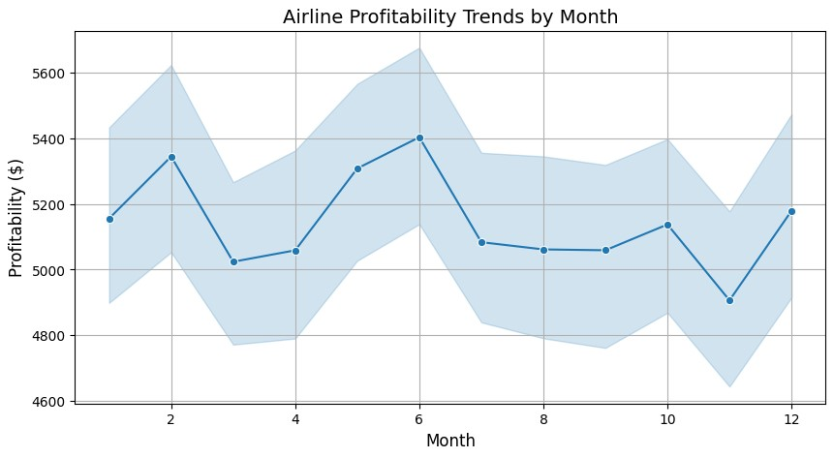
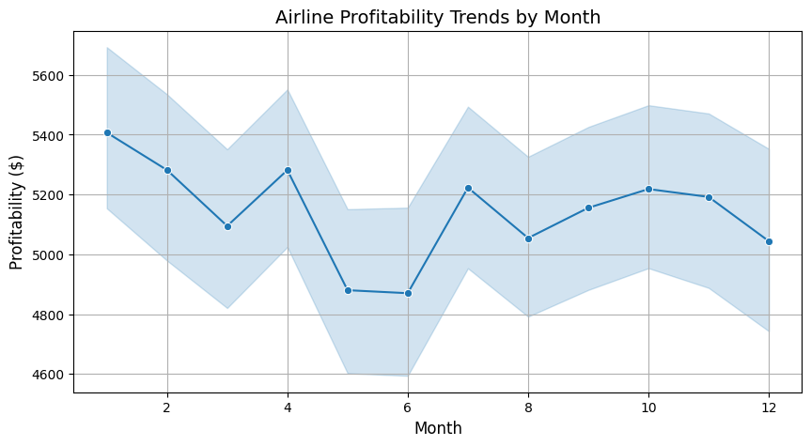
Predicting Flight Profitability: Airline Profitability Analysis
Profitability shows seasonal fluctuations throughout the year.
Peaks observed in February, June, October and December, indicating high travel demand during these months.
Low profitability in March, May and November, suggesting off-peak travel seasons.
Profitability shows seasonal fluctuations throughout the year.
Peaks observed in January, April, July, and October, indicating high travel demand during these months.
Low profitability in March, May and November, suggesting off-peak travel seasons.
(Actual)
(Schedule)

Slide 10
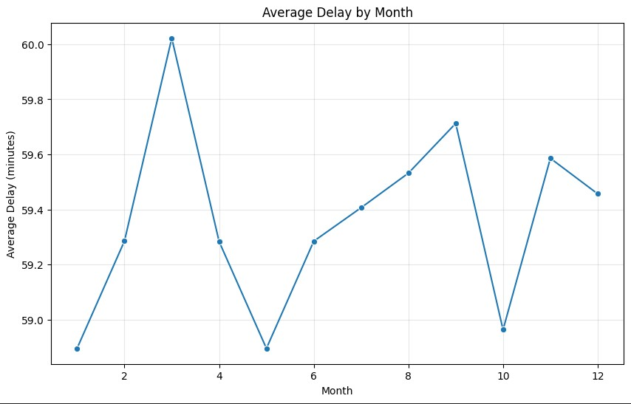
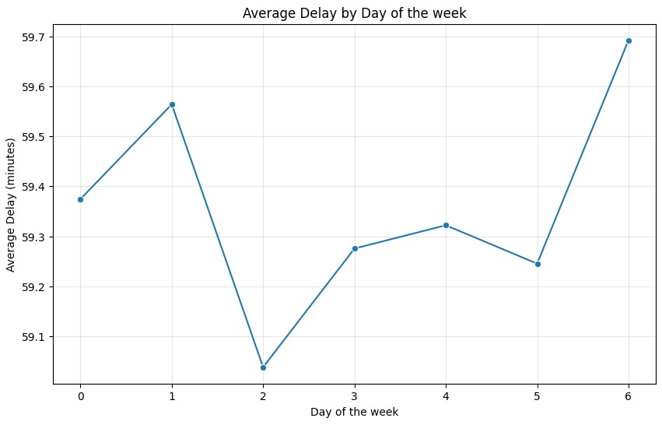
Predicting Flight Profitability: Seasonal and Weekly Delay Trends
📌 Average Delay by Month
The delay varies throughout the year, with peaks in certain months.
February shows the highest average delay, possibly due to weather conditions
or operational challenges.
October has the lowest delay, indicating better operational efficiency.
📌 Average Delay by Day of the Week
Flight delays fluctuate across different days of the week.
Tuesdays show the lowest. Sundays experience the highest delays, possibly due
to increased weekend travel.
t delays, suggesting operational efficiency mid-week.
📌 Key Insights
Understanding seasonal and weekly trends helps in better resource allocation.
Airlines can optimize flight schedules and improve efficiency to reduce delays.

Slide 11
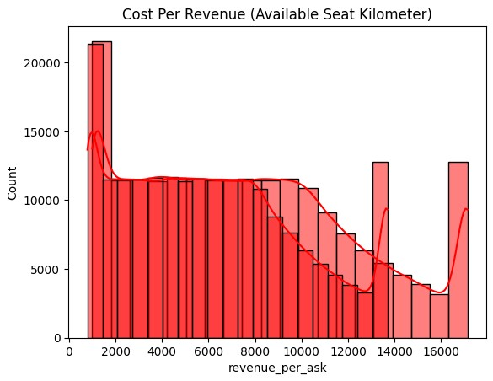
Predicting Flight Profitability: Distribution of Revenue per Cost
Cost Per Revenue (Available Seat Kilometer) Analysis
Understanding cost efficiency about revenue generated per available seat kilometer.
Identifying patterns and distributions to optimize airline operations.
Distribution of Revenue Per ASK
Highly skewed distribution, indicating a large concentration of flights with lower revenue per ASK.
Multiple peaks suggest different operational segments
Key Business Insights
Cost efficiency is critical in the low-revenue ASK segment to maintain profitability.
Potential optimization opportunities in mid-range revenue flights to maximize cost per ASK.
High-revenue flights show sporadic peaks, possibly reflecting premium routes or seasonal demand.

Slide 12
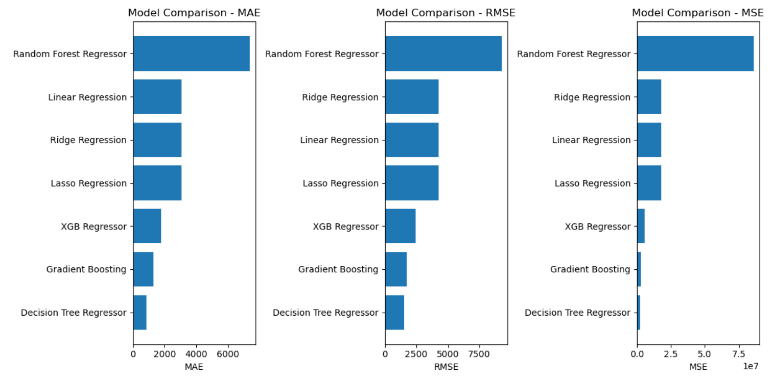




Model Selection: Choosing the Right Algorithm for Prediction
2
Random Forest
1
Linear Regression
3
XGBoost
Choosing the right algorithm is crucial for accurate predictions.

Slide 13


Model Training & Validation: Ensuring Accuracy and Reliability
1
Training Data
Use historical data to train the model.
2
Validation Data
Evaluate performance on unseen data.
3
Hyperparameter Tuning
Optimize model parameters for best results.

Slide 14






Linear Regression | Gradient Boosting | Decision Tree Regressor | Random Forest Regressor | XGB Regressor
3087.2360 | 1283.7799 | 1852.3954 | 7378.9686 | 1797.2886
4258.8085 | 1742.6128 | 1544.7264 | 9267.5648 | 2416.2944
0.9444 | 0.9907 | 0.9927 | 0.7366 | 0.9821
1813744.7 | 3036699.4714 | 2386179.8001 | 85887756.4216 | 5838478.8055
Methods
MAE
RMSE
R²
MSE

Slide 15
Conclusion:
Best Model: Gradient Boosting (with PCA) achieved the lowest RMSE (2757) and demonstrated consistency through cross-validation.
Key Insights from EDA: Features like revenue_per_ask, fuel_efficiency, and maintenance_downtime were the most influential, highlighting operational efficiency as a critical driver.
Why RMSE? It provides actionable insights into prediction errors in the same units as the target variable, making it ideal for decision-making.
The Gradient Boosting model successfully achieves the project objectives: · Prediction Accuracy: o High accuracy in predicting airline profitability, enabling confident decision-making. · Interpretability: o SHAP values provide actionable insights into the most impactful features. o Helps operators focus on areas like optimizing revenue streams and reducing operational costs. · Generalization to Unseen Data: Consistent cross-validation results confirm the model's robustness and applicability to real-world scenarios.
Thank You!

Slide 16


